Slide 1
ALGORITHM

Slide 2
Introduction
Algorithms act as an exact list of instructions that conduct specified actions step by step in either hardware- or software-based routines.
Algorithms are widely used throughout all areas of IT.
In computer programming terms, it is a set of well-defined instructions to solve a particular problem. It takes a set of input(s) and produces the desired output.

Slide 3
Contd…
E.g.: An algorithm to add two numbers:
Step 1: Take two number inputs
Step 2: Add numbers using the + operator
Step 3: Display the result

Slide 4
Properties of Algorithm:
Input and output should be defined precisely.
Each step in the algorithm should be clear and unambiguous.
Algorithms should be most effective among many different ways to solve a problem.
An algorithm shouldn't include computer code. Instead, the algorithm should be written in such a way that it can be used in different programming languages.

Slide 5
Qualities of a good algorithm:
The following are the primary factors that are often used to judge the quality of the algorithms.
Time – To execute a program, the computer system takes some amount of time. The lesser is the time required, the better is the algorithm.
Memory – To execute a program, computer system takes some amount of memory space. The lesser is the memory required, the better is the algorithm.
Accuracy – Multiple algorithms may provide suitable or correct solutions to a given problem, some of these may provide more accurate results than others, and such algorithms may be suitable.

Slide 6
Contd…
E.g.: algorithm to print “Good Morning”
Step 1: Start
Step 2: Print “Good Morning”
Step 3: Stop

Slide 7
Algorithm Examples:
Algorithm 1: Add two numbers entered by the user:
Step 1: Start
Step 2: Declare variables num1, num2 and sum.
Step 3: Read values num1 and num2.
Step 4: Add num1 and num2 and assign the result to sum.
sum←num1+num2
Step 5: Display sum
Step 6: Stop

Slide 8
Algorithm 2: Find the largest number among three numbers:
Step 1: Start
Step 2: Declare variables a,b and c.
Step 3: Read variables a,b and c.
Step 4: If a > b
If a > c
Display a is the largest number.
Else
Display c is the largest number.
Else
If b > c
Display b is the largest number.
Else
Display c is the greatest number.
Step 5: Stop

Slide 9
Algorithm 3: Find Roots of a Quadratic Equation ax² + bx + c = 0:
Step 1: Start
Step 2: Declare variables a, b, c, D, x1, x2, rp and ip;
Step 3: Calculate discriminant
D ← b2-4ac
Step 4: If D ≥ 0
r1 ← (-b+√D)/2a
r2 ← (-b-√D)/2a
Display r1 and r2 as roots.
Else
Display roots are imaginary
Step 5: Stop

Slide 10
Algorithm 4: Find the factorial of a number:
Step 1: Start
Step 2: Declare variables n, factorial and i.
Step 3: Initialize variables
factorial ← 1
i ← 1
Step 4: Read value of n
Step 5: Repeat the steps until i = n
5.1: factorial ← factorial*i
5.2: i ← i+1
Step 6: Display factorial
Step 7: Stop

Slide 11
Algorithm 5: Check whether a number is prime or not:
Step 1: Start
Step 2: Declare variables n, i, flag.
Step 3: Initialize variables
flag ← 1
i ← 2
Step 4: Read n from the user.
Step 5: Repeat the steps until i=(n/2)
5.1 If remainder of n÷i equals 0
flag ← 0
Go to step 6
5.2 else, i ← i+1
Step 6: If flag = 0
Display n is not prime
else
Display n is prime
Step 7: Stop

Slide 12
Algorithm 6: Find the Fibonacci series till the term less than 1000:
Step 1: Start
Step 2: Declare variables first_term,second_term and temp.
Step 3: Initialize variables first_term ← 0 second_term ← 1
Step 4: Display first_term and second_term
Step 5: Repeat the steps until second_term ≤ 1000
5.1: temp ← second_term
5.2: second_term ← second_term + first_term
5.3: first_term ← temp
5.4: Display second_term
Step 6: Stop

Slide 13
Needs to study Data Structures and Algorithms
You will be able to write code that is more efficient and more reliable.
You will also be able to solve problems more quickly and more effectively.
Informally, an algorithm is nothing but a mention of steps to solve a problem. They are essentially a solution.
Programming is all about data structures and algorithms.
Data structures are used to hold data while algorithms are used to solve the problem using that data.
It also teaches you the science of evaluating the efficiency of an algorithm. This enables you to choose the best of various choices.

Slide 14
Contd…
E.g.: Problem: Find the factorial of n:
Initialize fact = 1
For every value v in range 1 to n:
Multiply the fact by v
fact contains the factorial of n

Slide 15
Contd…
Next is a code for finding the factorial of a number in C++.
int factorial(int n) {
int fact = 1;
for (int v = 1; v <= n; v++) {
fact = fact * v;
}
return fact;
}

Slide 16
Use of Data Structures and Algorithms to Make Your Code Scalable
1. Time:
Assume, Haroon and Sohail are attempting to solve the basic issue of finding the sum of the initial 10¹¹ natural numbers. While Sohail was composing the algorithm, Haroon actualized it demonstrating that it very simply.
Algorithm (by Sohail):
Initialize sum = 0
for every natural number n in range 1 to 10¹¹(inclusive):
add n to sum
sum is your answer

Slide 17
Contd…
Code (by Haroon):
int findSum() {
int sum = 0;
for (int v = 1; v <= 100000000000; v++) {
sum += v;
}
return sum;
}
Let's sneak into their workspace and listen to their conversation.
Haroon: “Let's run this code and find out the sum.”
Sohail: “I ran this code a few minutes back but it's still not showing the output. What's wrong with it?”

Slide 18
Contd…
Oops, something went wrong! Going back and trying to run it again won't help. So let's analyse what's wrong with this simple code.
Most valuable resources for a computer program are time and memory.
The time taken by the computer to run code is:
Time to run code = number of instructions * time to execute each instruction
The number of instructions depends on the code you used, and the time taken to execute each code depends on your machine and compiler.
In this case, the total number of instructions (depends on the code you used, and the time taken to execute each code) executed (let's say x) are:
x = 1 + (10¹¹ + 1) + (10¹¹) + 1 = 2 * 10¹¹ + 3

Slide 19
Contd…
Let the computer can execute y = 10⁸ instructions in one second, so the time taken to run above code is:
Time to run y instructions = 1 second
Time to run 1 instruction = 1 / y seconds
Time to run x instructions = x * (1/y) seconds = x / y seconds
Hence,
Time to run the code = x / y
= (2 * 10¹¹ + 3) / 10⁸ (greater than 33 minutes)

Slide 20
Contd…
You can use the right method i.e.; by using the sum of first N natural numbers and is given by the formula:
Sum = N * (N + 1) / 2
Converting it into code will look something like this:
int sum(int N) {
return N * (N + 1) / 2;
}
The above code executes in just one instruction and gets the task done no matter what the value is.
The time taken to solve the problem, in this case, is 1/y (which is 10 nanoseconds).

Slide 21
Contd…
2. Scalability:
It means the quality of an algorithm to handle the problem of larger size.
Case 1: Consider the problem of setting up a classroom of 50 students. One of the simplest solutions is to book a room, get a blackboard, a few chalks, and the problem is solved.
But if the size of the problem increases i.e., if the number of students = 200, the solution still holds but it needs more resources. In this case, you will probably need a much larger room, a projector screen and a digital pen.
But if the number of students = 1000, then the solution fails or uses a lot of resources when the size of the problem increases. This means, your solution wasn't scalable.

Slide 22
Contd…
E.g. of scalable solution: Consider a site like ‘Khan Academy’, millions of students can see videos, read answers at the same time and no more resources are required. So, the solution can solve the problems of larger size under resource crunch.
If you see our first solution to find the sum of first N natural numbers, it wasn't scalable. It's because it required linear growth in time with the linear growth in the size of the problem. Such algorithms are also known as linearly scalable algorithms.
Our second solution was very scalable and didn't require the use of any more time to solve a problem of larger size. These are known as constant-time algorithms.

Slide 23
Examples of an Algorithm's Efficiency:
Example 1: Age Group Problem
Finding the people of a certain age group can easily be solved with a little modified version of the binary search algorithm (assuming that the data is sorted).
The naive algorithm which goes through all the persons one by one, and checks if it falls in the given age group is linearly scalable.
Whereas, binary search claims itself to be a logarithmically scalable algorithm. This means that if the size of the problem is squared, the time taken to solve it is only doubled.

Slide 24
Contd…
Example 2: DNA Problem
DNA is a molecule that carries genetic information. They are made up of smaller units which are represented by Roman characters A, C, T, and G.
To find out the occurrence of a particular pattern in a DNA strand.
It is a famous problem, the simplest algorithm takes the time proportional to
(Number of character in DNA strand) * (number of characters in pattern)
A typical DNA strand has millions of such units. KMP algorithm can get this done in time which is proportional to:
(Number of character in DNA strand) + (number of characters in pattern)
The * operator replaced by + makes a lot of change.

Slide 25
Asymptotic Analysis:
Asymptotic analysis refers to computing the running time of any operation in mathematical units of computation.
E.g.: the running time of one operation is computed as f(n) and may be for another operation it is computed as g(n²). This means the first operation running time will increase linearly with the increase in n and the running time of the second operation will increase exponentially when n increases. Similarly, the running time of both operations will be nearly the same if n is significantly small.
Usually, the time required by an algorithm falls under three types −
1. Best Case: Minimum time required for program execution.
2. Average Case: Average time required for program execution.
3. Worst Case: Maximum time required for program execution.

Slide 26
Asymptotic Notations:
Commonly used asymptotic notations to calculate the running time complexity of an algorithm are:
Big Ο Notation: It represents the upper bound of the running time of an algorithm. Thus, it gives the worst-case complexity of an algorithm.
Ω Notation: It represents the lower bound of the running time of an algorithm. Thus, it provides the best case complexity of an algorithm..
θ Notation: It encloses the function from above and below, i.e.; it is used for analysing the average-case complexity of an algorithm.

Slide 27
Master Theorem
The master method is a formula for solving recurrence relations of the form:
T(n) = aT(n/b) + f(n),
Where,
n = size of input
a = number of sub problems in the recursion
n/b = size of each sub problem. All sub problems are assumed to have the same size.
f(n) = cost of the work done outside the recursive call.
Here, a ≥ 1 and b > 1 are constants, and f(n) is an asymptotically positive function (ie; for a sufficiently large value of n, we have f(n) > 0 ).

Slide 28
Contd…
Where, f(n) = Θ(n^{k} log^{p} n)
Case 1: If log_{b} a > k, then T(n) = Θ(n^{log}_{b} ª )
Case 2: If log_{b} a = k, then
If p> -1, then T(n)= Θ(n^{k} *log(log^{p+1} n)).
If p = -1, then T(n)= Θ(n^{k} *log(log n)).
If p < -1, then T(n)= Θ(n^{k} ).
Case 3: If log_{b} a < k, then
If p> 0, then T(n)= Θ(n^{k} *log(log^{p} n)).
If p < 0, then T(n)= Θ(n^{k} ).
The master theorem is used in calculating the time complexity of recurrence relations (divide and conquer algorithms) in a simple and quick way.

Slide 29
Solved Example of Master Theorem:
T(n) = 3T(n/2) + n²
Here,
a = 3
n/b = n/2
f(n) = n²
^{K=2}
log_{b} a = log₂ 3 ≈ = 1.58 < 2
ie. log_{b} a < k
Case 3 implies here.
Thus, T(n) = f(n) = Θ(n²)

Slide 30
Master Theorem Limitations:
The master theorem cannot be used if:
T(n) is not monotone. eg. T(n) = sin n
f(n) is not a polynomial. eg. f(n) = 2^{n}
a is not a constant. eg. a = 2n
a < 1

Slide 31
Divide and Conquer Algorithm:
It is a strategy of solving a large problem by breaking the problem into smaller sub-problems solving the sub-problems, and combining them to get the desired output.
Here are the steps involved:
Divide: Divide the given problem into sub-problems using recursion.
Conquer: Solve the smaller sub-problems recursively. If the sub problem is small enough, then solve it directly.
Combine: Combine the solutions of the sub-problems that are part of the recursive process to solve the actual problem.

Slide 32
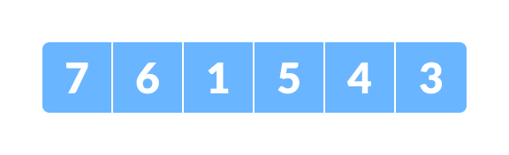
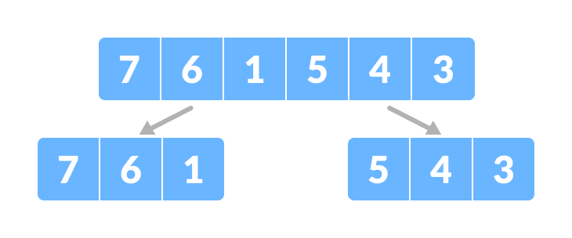
Contd…
Example: to sort an array using the divide and conquer approach (i.e.; merge sort ).
Let the given array be:
Fig: Array for merge sort
Divide the array into two halves:

Slide 33
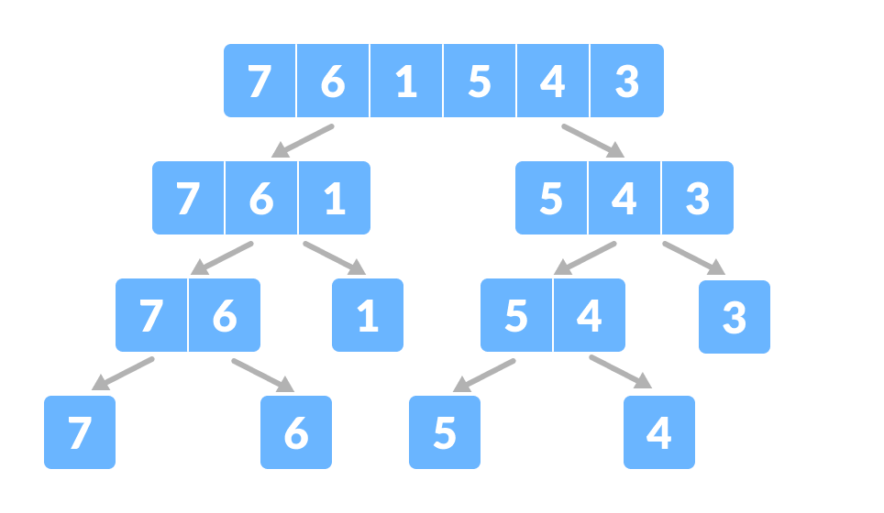
Contd…
Again, divide each subpart recursively into two halves until you get individual elements.

Slide 34
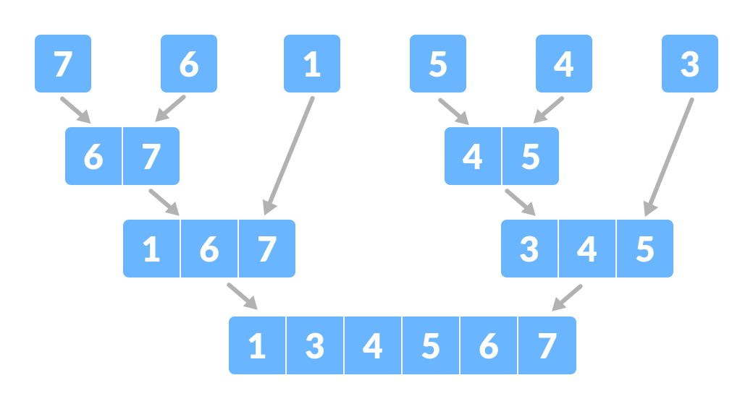
Contd…
Now, combine the individual elements in a sorted manner. Here, conquer and combine steps go side by side.

Slide 35
Advantages of Divide and Conquer Algorithm:
The complexity for the multiplication of two matrices using the naive method is O(n³), whereas using the divide and conquer approach (i.e. Strassen's matrix multiplication) is O(n^{2.8074}).
This approach is suitable for multiprocessing systems.
It makes efficient use of memory caches

Slide 36
Divide and Conquer Applications:
Binary Search
Merge sort
Quick sort
Strassen's Matrix multiplication
Karatsuba Algorithm

